Slide 1

LIGHTHOUSE
A safe harbor from the storm
Notes:
Welcome judges. We're team lighthouse.

Slide 2

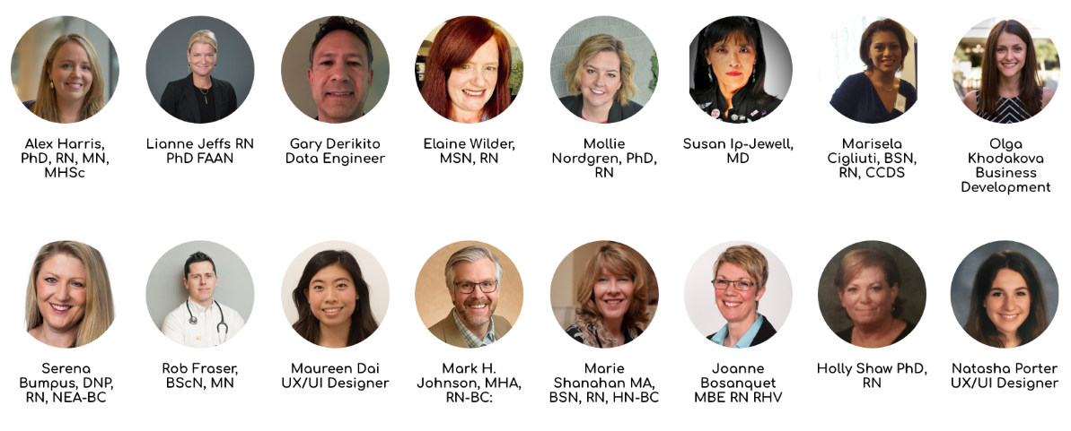
TEAM
Notes:
We're a group of clinicians, designers and developers bringing our creativity and compassion to tackle the challenge of resiliency and self care.

Slide 3

THE PROBLEM
Being ‘others oriented’, nurses tend to neglect cultivating their own social and emotional well-being.
We must:
Support “wounded” nurses
Enhance a sense of solidarity
Provide resiliency resources
Promote self-care
Notes:
The problem we're trying to solve is that nurses often care more about others than they do themselves.
Right now nurses are going a million miles a minute and suffering in unprecedented ways. We want to focus on their emotional well-being through solidarity, self-care and resiliency-building

Slide 4
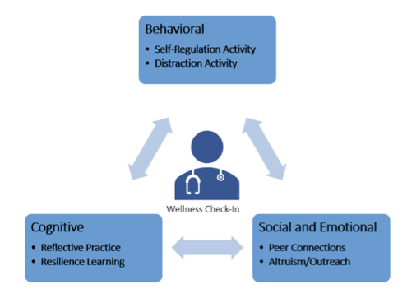
THE SOLUTION
A ChatBot application to guide nurses TO A SAFE HARBOR
Designed by nurses for nurses
Notes:
The solution is a chatbot application that provides proactive check-ins and just-in-time resources based on their emotional state.

Slide 5



LIGHTHOUSE FEATURES
Secure, private & anonymized space for nurses to engage in conversation
Resiliency-boosting activities
based on user needs at different points in time
Mood wellness tracking that can be shared with users & healthcare organizations
It works the way nurses work!
Notes:
The key features of lighthouse are it's security and privacy. These features offer nurses a safe space to go to when they need Micro-doses of resiliency-boosting activities. These activities are provided based on user needs, and wellness tracking can provide feedback on how users are doing.

Slide 6

DEMO
Notes:
Now, our demo

Slide 7

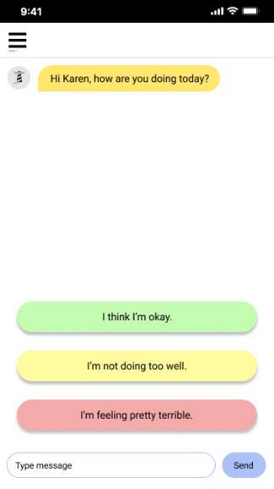
Notes:
Lighthouse can proactively reach out to nurses to engage in self-care and behavioral change goals and activities.
Here we see our user Karen responding to prompts about her well-being.

Slide 8
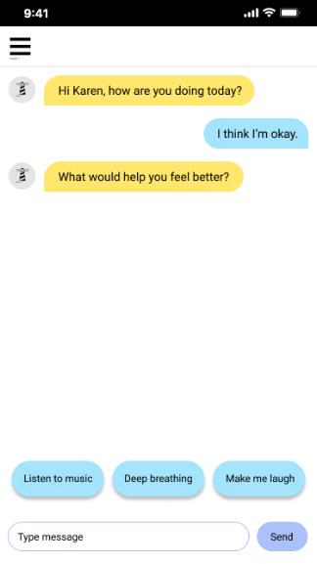
Notes:
Lighthouse can use Artificial Intelligence to analyze responses and provide options.

Slide 9
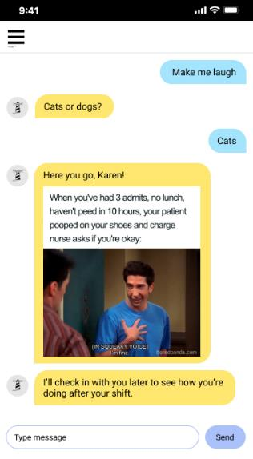
Notes:
Here Karen is has chosen an activity based on her individual preferences, like humor; in this case a funny nursing meme. Lighthouse can follow up and continue to check-in later to see how Karen's mood has changed.

Slide 10
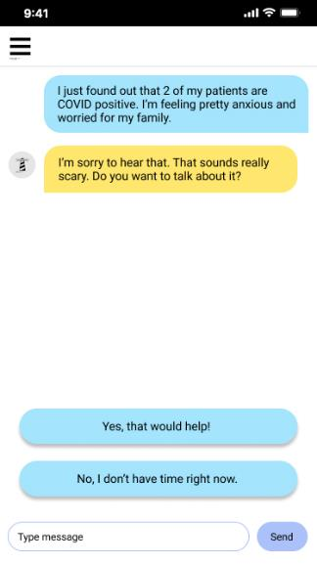
Notes:
Lighthouse is not only for nursing humor, it's Artificial Intelligence and knowledge base will be responsive to complex issues that nurses face 24/7, like covid-19 related anxiety.

Slide 11
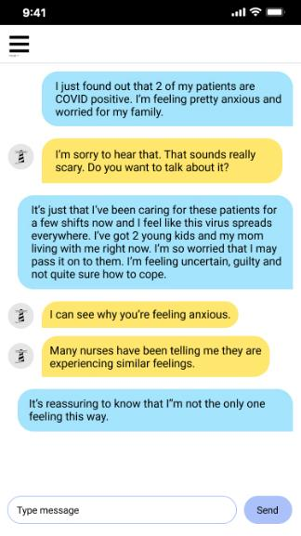
Notes:
Lighthouse provides feedback from other user's engagement to create an awareness that they are part of a larger nursing community.

Slide 12
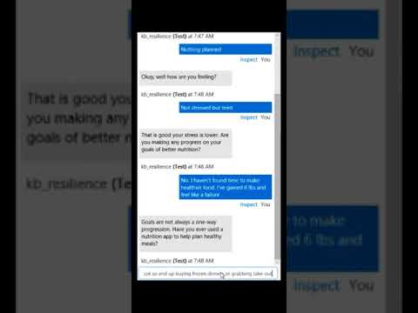
PROOF OF CONCEPT
Notes:
Our team was able to get Microsoft Azure set up, and run the Q-N-A Bot to build the chat bot. We moved beyond the concept and into production of the Lighthouse platform.
In the background there is AI capability and a knowledge base that we started to train. Over time, as more users engage with the bot, it will identify trends and changes in the user base. There is also the potential to connect to the Microsoft Cognitive services with natural language processing and facial recognition that can integrate into the platform.

Slide 13
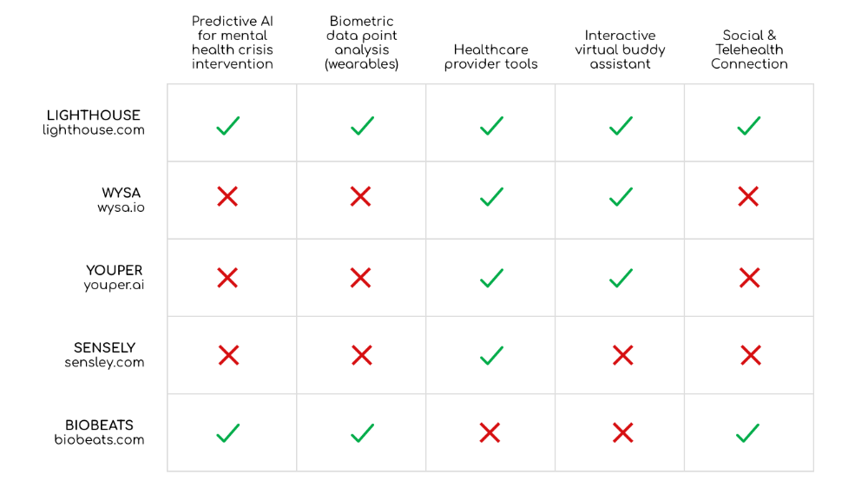
COMPETITVE ANALYSIS
Notes:
Our competitive analysis shows that there are no direct competitors at this time

Slide 14








BUSINESS MODEL
Non-profit partner funded app
Subscription Model
Free to nursing students and member associations
Leverage Data
Wellness initiatives, research, practice standards and policy
Distribution Channel
Professional Nursing Associations and Schools
Notes:
We’re a not-for-profit organization, recruiting industry support to provide a free app to nurses from international professional nursing organizations. The aggregate data will inform future nursing research, policy & advocacy efforts. We currently have endorsement and interest to fund from global nursing associations representing over ½ million nurses.

Slide 15



THANK YOU
www.lighthouse.com
@lighthouse
@lighthouse
@lighthouse

